Slide 1

CogSci Attempt

Slide 2
Outline
Research questions
Model description
World model
Value model
Experiment 1: Subjective randomness estimates
Experiment 2: Engagement with event sequences
Potential problems
Future directions

Slide 3
Note
Key experimental and modelling decisions that may have caused undesirable outcomes are underlined and italicized throughout the presentation and will be discussed in detail in the ‘Potential problems’ section

Slide 4
Questions
1) Can we define a criterion by which we decide what to attend to & what to ignore? (in the informational domain)
2) Can this criterion provide a unifying framework with which to understand novelty and familiarity preferences in infant looking time studies?

Slide 5
Our angle
We narrowed down this question by focusing on what kind of temporal structure makes an object of attention engaging.
This provides a useful separation of two sources of engagement:
Engagement based on salience/interestingness of the stimulus alone
Engagement based on how the stimulus fits in with previous experiences
We focus on the second source: Stimuli are matched for salience in isolation, but the temporal context in which they appear can make them more or less engaging.

Slide 6
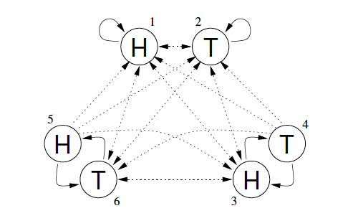
World model
We posit that humans have (or can construct) a generative model of temporal sequences in their minds
We chose as our model a sequence-generating Hidden Markov Model
This HMM generates binary sequences (e.g. HTHTTTTT)
It can be in one of six states:
Generate H’s (1), generate T’s (2)
Generate H, then T (3&4)
Generate T, then H (5&6)
Griffiths & Tenenbaum (2003)

Slide 7
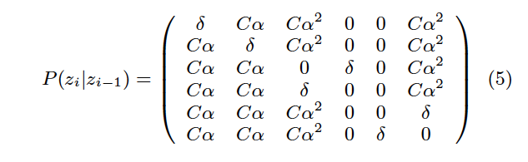
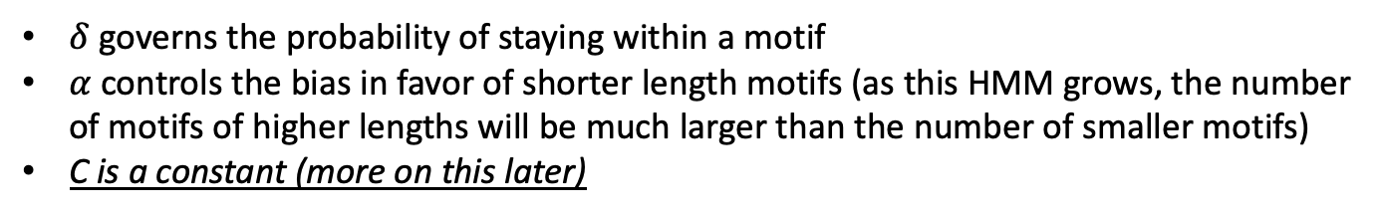
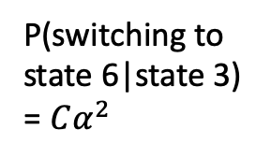
World model
The probability of transitioning between states is governed by a transition matrix, which looks like this:
P(switching to state 6|state 3) = $Cα^{2}$
Griffiths & Tenenbaum (2003)
$δ$ governs the probability of staying within a motif
$α$ controls the bias in favor of shorter length motifs (as this HMM grows, the number of motifs of higher lengths will be much larger than the number of smaller motifs)
C is a constant (more on this later)

Slide 8
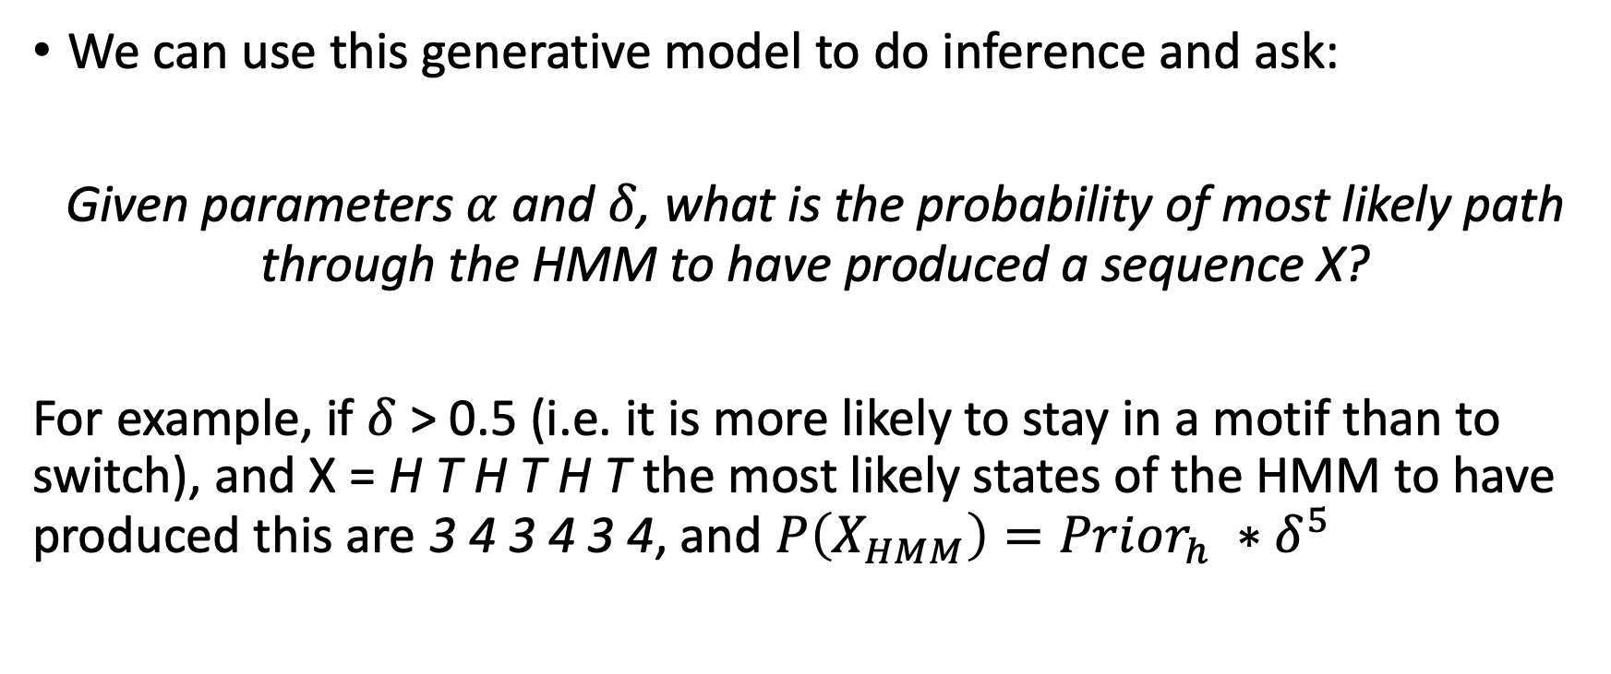
World model
We can use this generative model to do inference and ask:
Given parameters $α$ and $δ$, what is the probability of most likely path through the HMM to have produced a sequence X?
For example, if $δ$> 0.5 (i.e. it is more likely to stay in a motif than to switch), and X = H T H T H T the most likely states of the HMM to have produced this are 3 4 3 4 3 4, and $P\left(X_{HMM}\right)=Prior_{h} ∗δ^{5}$

Slide 9
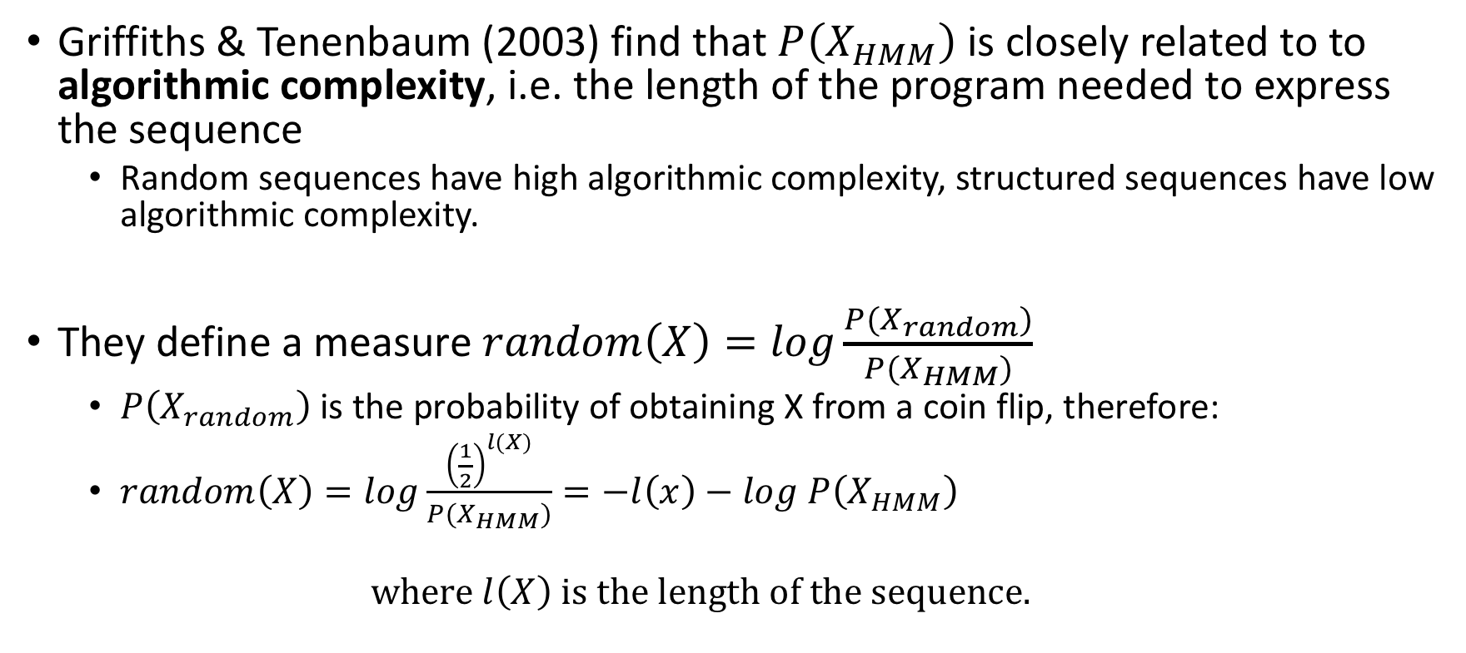
Value model
Griffiths & Tenenbaum (2003) find that $P\left(X_{HMM}\right)$ is closely related to to algorithmic complexity, i.e. the length of the program needed to express the sequence
Random sequences have high algorithmic complexity, structured sequences have low algorithmic complexity.
They define a measure $random\left(X\right)=log\frac{P(X_{random})}{P(X_{HMM})}$
$P\left(X_{random}\right)$is the probability of obtaining X from a coin flip, therefore:
$random\left(X\right)=log\frac{{\left(\frac{1}{2}\right)}^{l(X)}}{P(X_{HMM})}=−l\left(x\right)−log P\left(X_{HMM}\right)$
$$where l\left(X\right) is the length of the sequence.$$

Slide 10
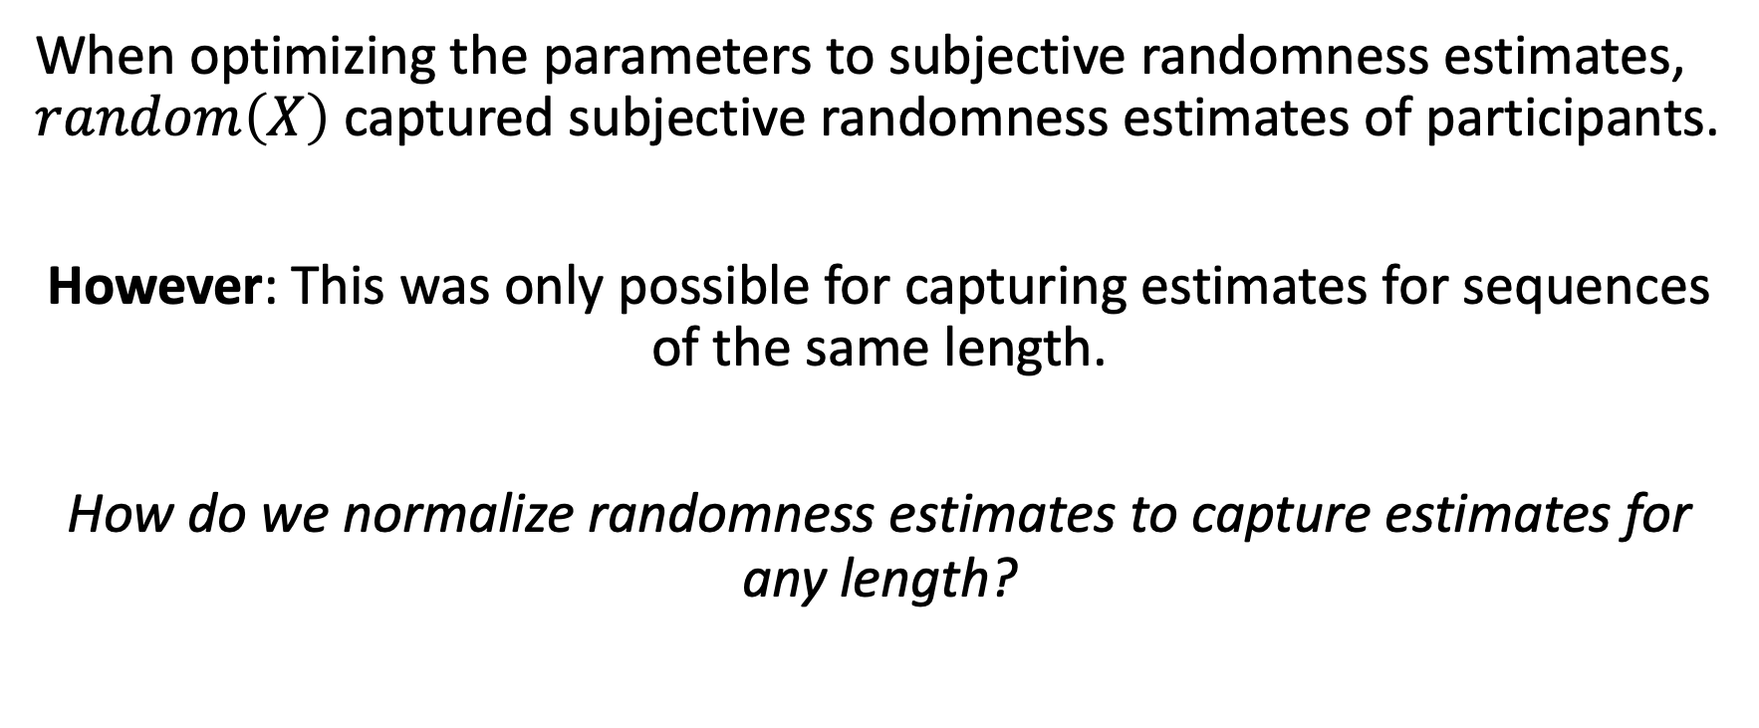
Value model
When optimizing the parameters to subjective randomness estimates, $random\left(X\right)$ captured subjective randomness estimates of participants.
However: This was only possible for capturing estimates for sequences of the same length.
How do we normalize randomness estimates to capture estimates for any length?

Slide 11
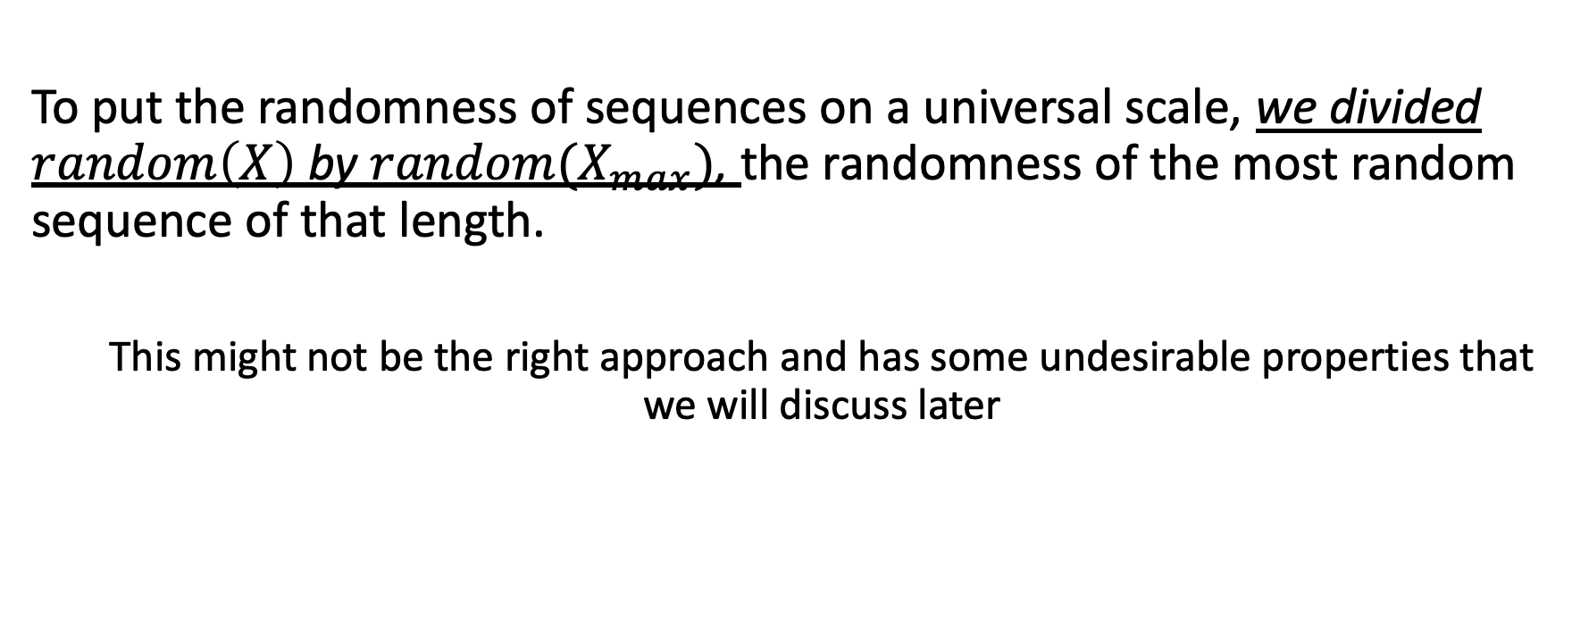
Normalization
To put the randomness of sequences on a universal scale, we divided $random\left(X\right)$ by ${random(X}_{max})$, the randomness of the most random sequence of that length.
This might not be the right approach and has some undesirable properties that we will discuss later

Slide 12
Experiment 1
Before moving to a measure of engagement, we calibrate the parameters of the HMM to match human subjective randomness estimates.
The point is that this computation of randomness may reflect a more general measure to extract structure from the world, and people may be anchoring their engagement to event sequences to that measure.
(We extend Griffith & Tenenbaum’s model to non-binary sequences)

Slide 13
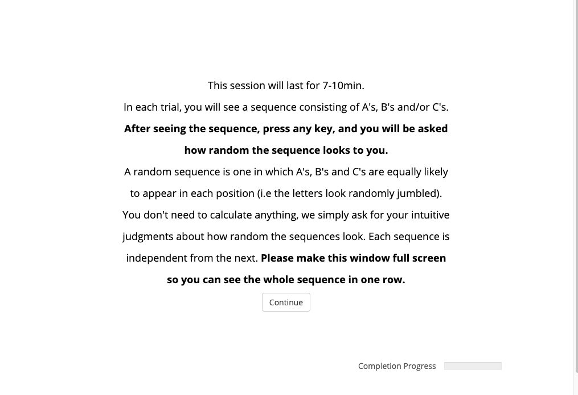
Experiment 1 - Instructions

Slide 14

Experiment 1 - Task

Slide 15
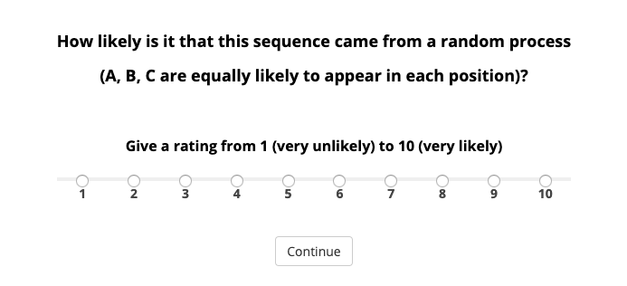
Experiment 1 – Subjective judgments

Slide 16
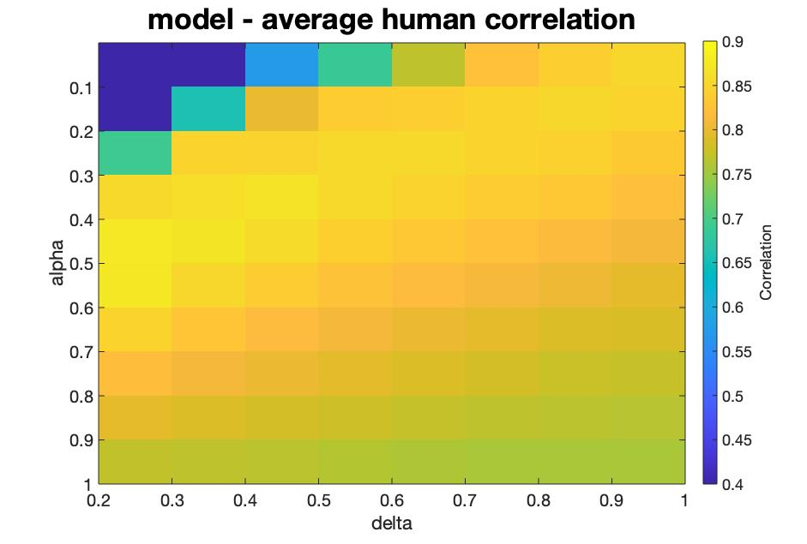

Experiment 1 - Results
We show a heatmap of correlations for different settings of $δ$ and $α$
Human randomness judgments are captured by a wide range of parameter settings. Possibly because different parameters fit judgments of different sequences (rather than all parameters being good for all sequences).

Slide 17
Experiment 2
This experiment was designed to measure the relationship between engagement with event sequences and their complexity
We use a proxy of engagement to facilitate running this study via mTurk:
We posit that engagement to:
1) predicting the next event in a sequence or 2) realizing that a temporal sequence is unpredictable

Slide 18
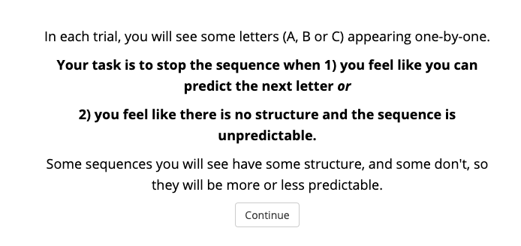
Experiment 2 - Instructions

Slide 19
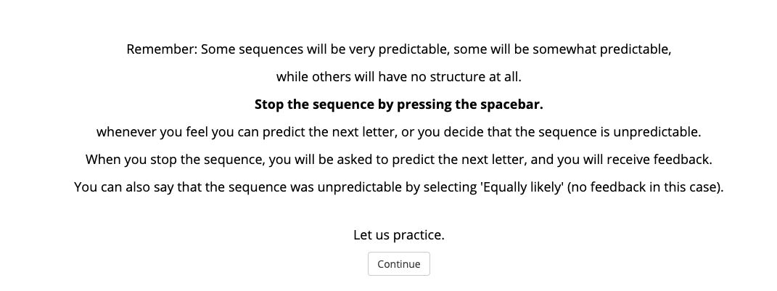
Experiment 2 - Instructions

Slide 20
Experiment 2 - Task
A
B
C
…
A
Self-termination of sequence

Slide 21
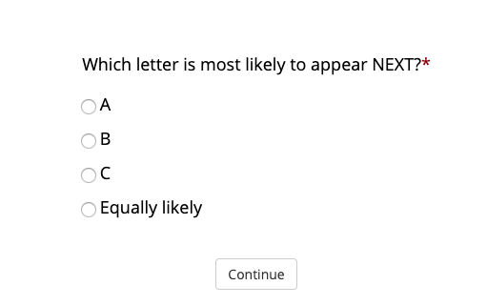
Experiment 2 - Prediction

Slide 22
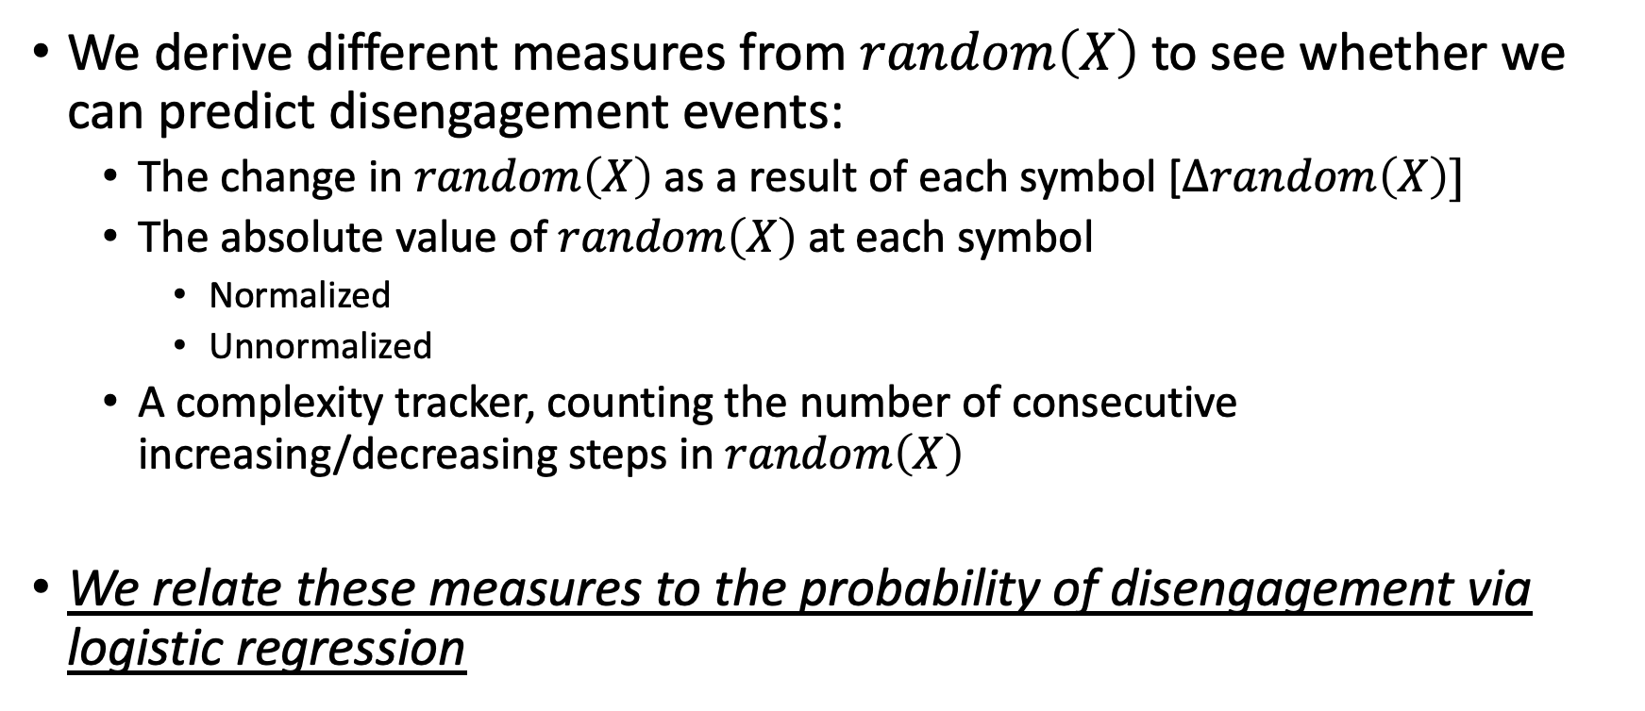
Experiment 2 - Analysis
We derive different measures from $random\left(X\right)$ to see whether we can predict disengagement events:
The change in $random\left(X\right)$as a result of each symbol [$Δrandom\left(X\right)]$
The absolute value of $random\left(X\right)$ at each symbol
Normalized
Unnormalized
A complexity tracker, counting the number of consecutive increasing/decreasing steps in $random\left(X\right)$
We relate these measures to the probability of disengagement via logistic regression

Slide 23
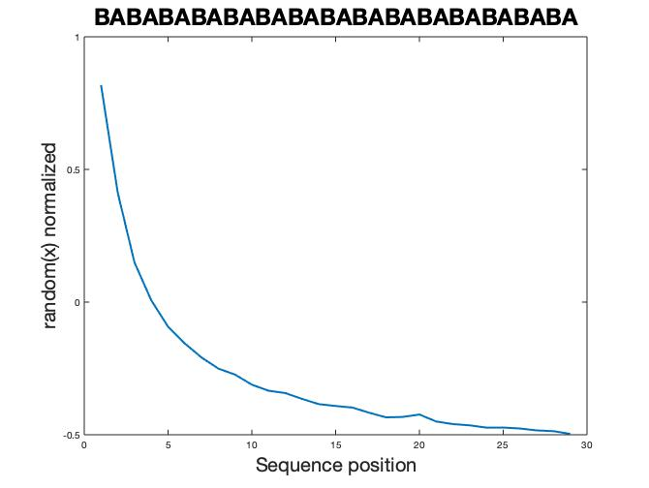
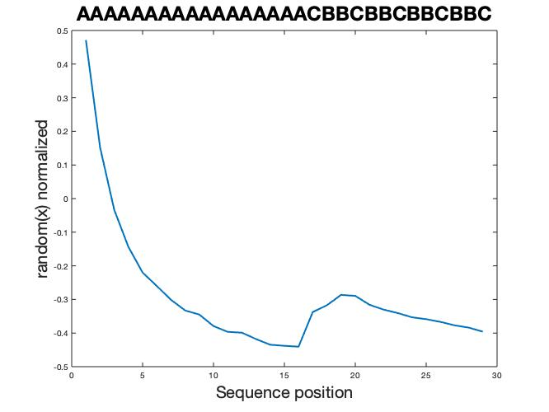
Model behavior of normalized random(X)
The model behaves as expected for deterministic sequences and violations:
Deterministic
Violation

Slide 24
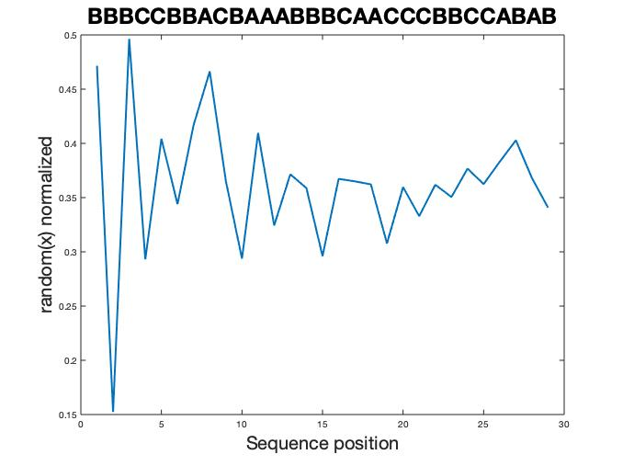
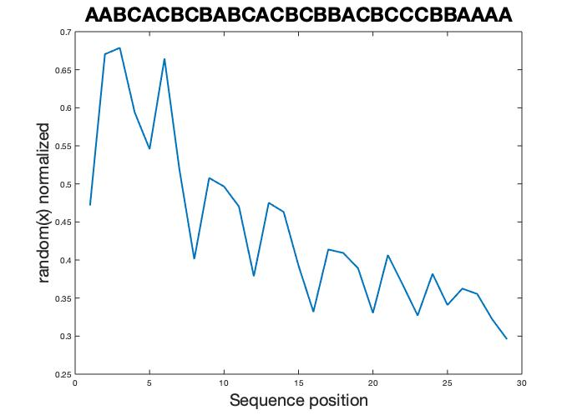
Model behavior of normalized random(X)
Random sequences exhibit oscillations of decreasing size
Some intermediate sequences exhibit rippling behavior
Random
Intermediate

Slide 25
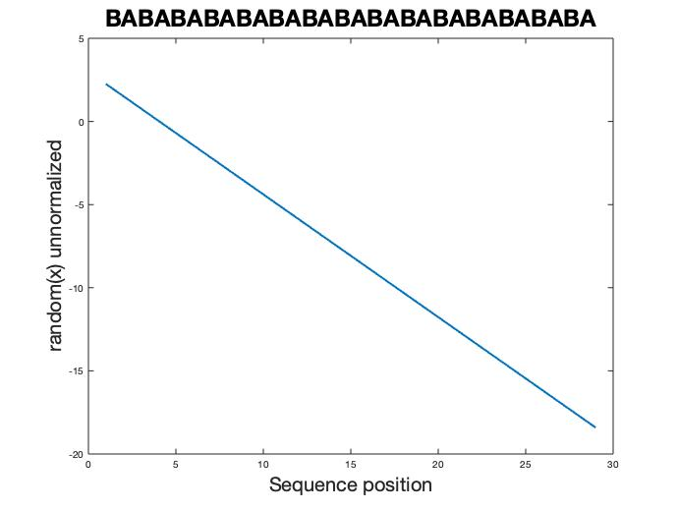
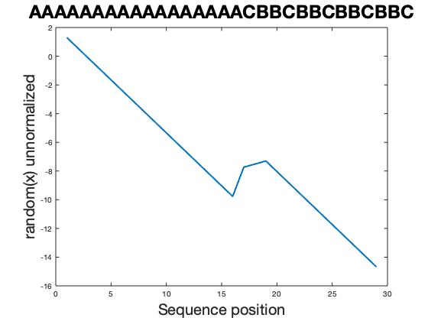
Model behavior of unnormalized random(X)
Deterministic
Violation

Slide 26
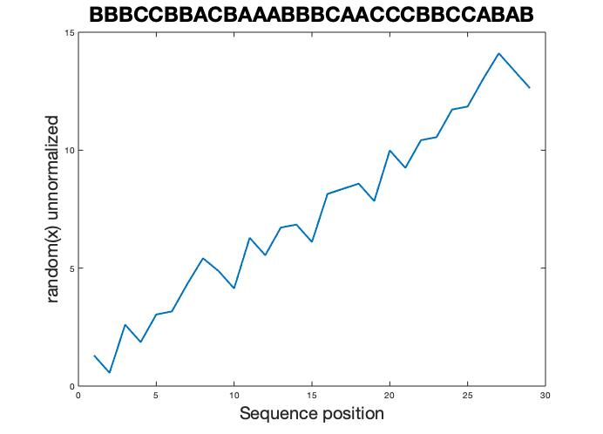
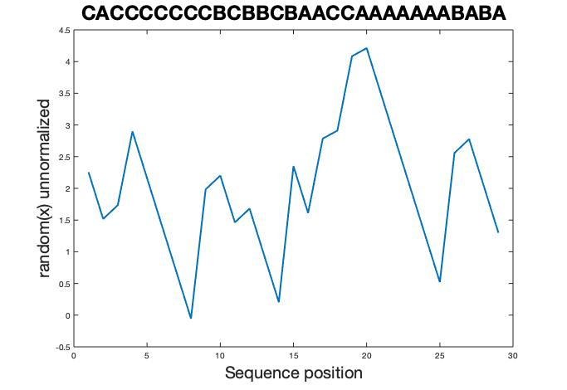
Model behavior of unnormalized random(X)
Random
Intermediate

Slide 27
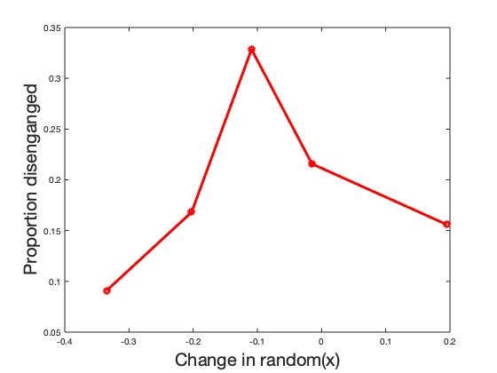
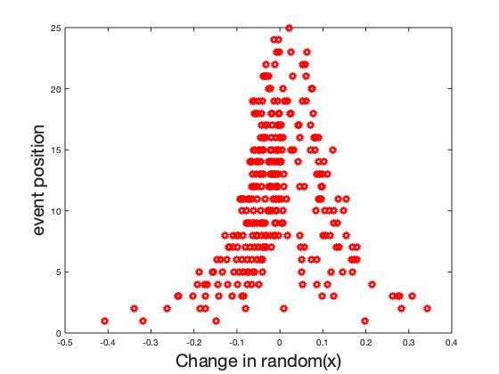
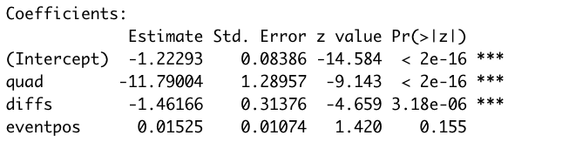
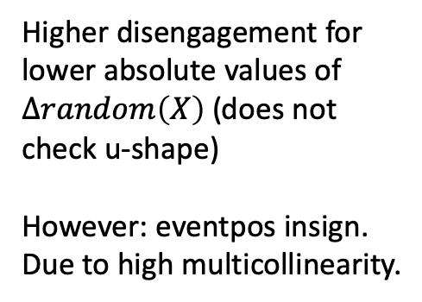



Experiment 2 – Results: $Δrandom\left(X\right)$
Higher disengagement for lower absolute values of $Δrandom\left(X\right)$ (does not check u-shape)
However: eventpos insign. Due to high multicollinearity.
$Δrandom\left(X\right)$^2 =
$Δrandom\left(X\right)$ =

Slide 28
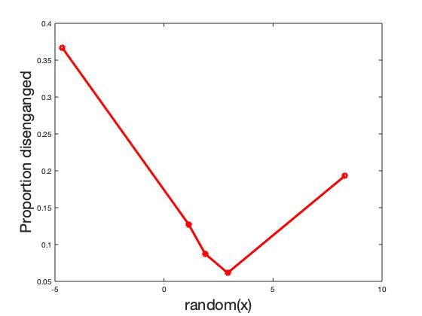
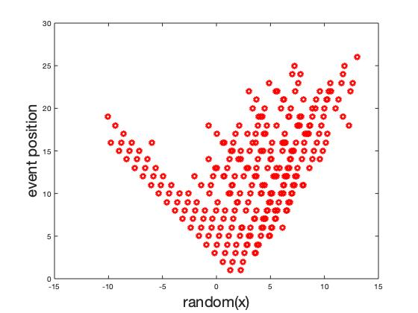
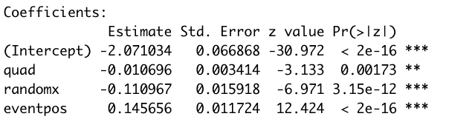



Experiment 2 – Results: $random\left(X\right)$ unnormalized
$random\left(X\right)$^2 =
Sig. but wrong sign
$random\left(X\right)$ =

Slide 29
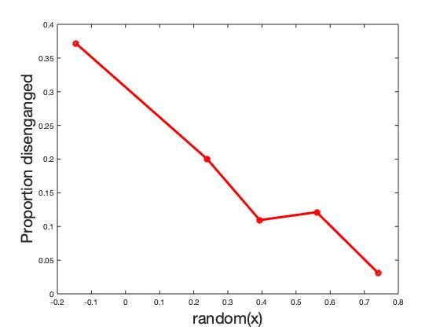
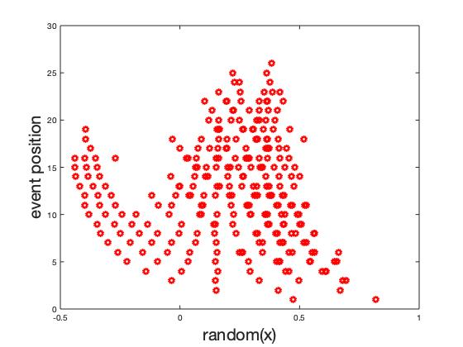
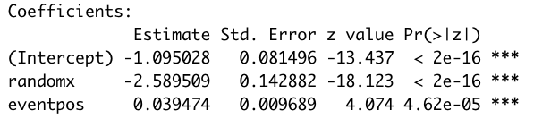

Experiment 2 – Results: $random\left(X\right)$ normalized
Indicates linear rel.,
not interesting

Slide 30
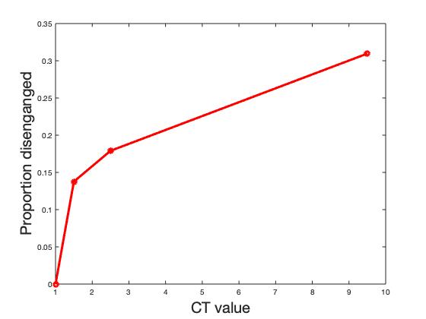
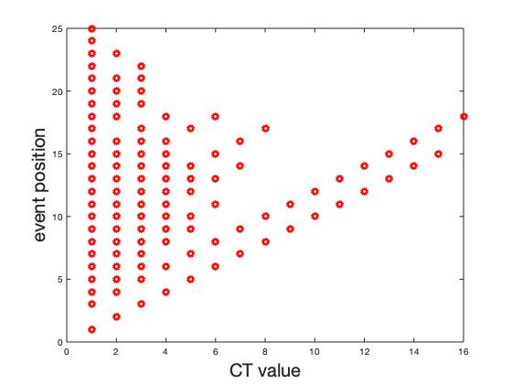
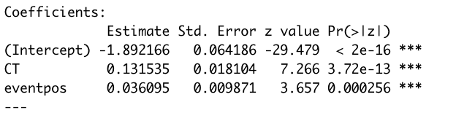
Experiment 2 – Results: Complexity tracker
Indicates higher likelihood of disengagement for higher tracker counts,
Again probably high multicollinearity

Slide 31
Potential problems – Experimental design
Experiment 2: We use a proxy of engagement to facilitate running this study via mTurk
We may be biasing people to look for patterns in the sequences, even when they are too random. It does become apparent quickly enough that a sequence is random, so people engage longer with random sequences than we expected

Slide 32


Potential problems – Modeling
Normalization: we divided $random\left(X\right)$ by ${random(X}_{max})$, the randomness of the most random sequence of that length.
1) This is likely causing strange behaviors in the intermediate case! These ripples corrupt our predictors, especially $Δrandom\left(X\right),$ which is close to 0 at the top of each ripple.
2) Also, normalization is causing violations later in the sequence to cause a smaller (rather than larger) change in normalized random(x)

Slide 33
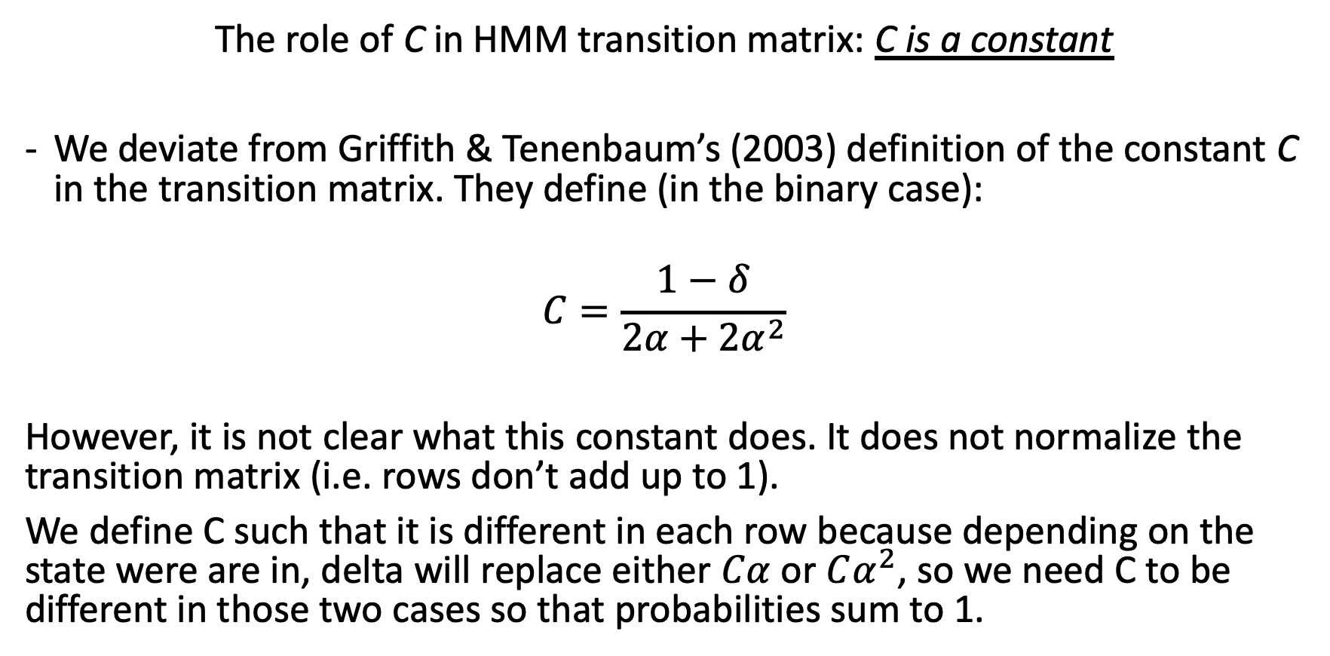
Potential problems – Modeling
The role of C in HMM transition matrix: C is a constant
We deviate from Griffith & Tenenbaum’s (2003) definition of the constant C in the transition matrix. They define (in the binary case):
$$C=\frac{1−δ}{2α+2α^{2}}$$
However, it is not clear what this constant does. It does not normalize the transition matrix (i.e. rows don’t add up to 1).
We define C such that it is different in each row because depending on the state were are in, delta will replace either $Cα$ or $Cα^{2}$, so we need C to be different in those two cases so that probabilities sum to 1.

Slide 34
Potential problems – Modeling
Experiment 2: Decision model: We relate these measures to the probability of disengagement via logistic regression
We did this analysis as a first pass, but it may not be the right statistical tool, because data availability (i.e. termination) depends on our predictor. We are looking into survival regression methods to rectify this.

Slide 35
Future directions
Experiment:
Measure true engagement (ability to change to next sequence/frame based on boredom/preference, not prediction of next symbol?)
Are temporal sequences the best way to test engagement? (screensavers?)
Model:
Hierarchical estimation of HMM parameters
Currently, we estimate a fixed set of parameters for the HMM for all sequences and participants
People may adapt their estimates of the HMM parameters within the sequence (structured sequences should result in lower predicted transition probabilities mid-sequence)
Explore better methods of normalizing sequence randomness

